Slide 1



JAVA MICRO PROJECT
PR D (19ITR028)
PROJECT GUIDE
Mentor Name
Designation
PROJECT MEMBER
Dushyant V
Notes:
30 June 2023
1-59
<number>

Slide 2
PROBLEM STATEMENT
Develop an Address Book application that allows users to store and manage their personal or professional contacts efficiently. The application should provide functionalities such as adding new contacts, editing or deleting existing contacts, searching for contacts, and displaying all contacts in an organized manner. The goal is to make it easy for users to manage their contacts and retrieve information when needed.

Slide 3
MODULES AND CONCEPT
Contact Management Module:
Concept – Encapsulation
Address Book Management Module:
Concept – Encapsulation, Aggregation
Search Module:
Concept – Iteration
Sorting Module:
Concept – Sorting Algorithm, Comparators
User Interface (CLI):
Concept – User interaction, Input/Output handling.
<number>

Slide 4
CODE
public class Contact {
private String name;
private String phoneNumber;
private String email;
public Contact(String name, String phoneNumber, String email) {
this.name = name;
this.phoneNumber = phoneNumber;
this.email = email;
}
public String getName() {
return name;
}
public void setName(String name) {
this.name = name;
}
public String getPhoneNumber() {
return phoneNumber;
}
public void setPhoneNumber(String phoneNumber) {
this.phoneNumber = phoneNumber;
}
public String getEmail() {
return email;
}
public void setEmail(String email) {
this.email = email;
}
public String toString() {
return "Name: " + name + ", Phone: " + phoneNumber + ", Email: " + email;
}
}
<number>

Slide 5
public boolean deleteContact(String name) {
return contacts.removeIf(contact -> contact.getName().equalsIgnoreCase(name));
}
public Contact searchContact(String name) {
for (Contact contact : contacts) {
if (contact.getName().equalsIgnoreCase(name)) {
return contact;
}
}
return null;
}
public void displayAllContacts() {
if (contacts.isEmpty()) {
System.out.println("No contacts available.");
} else {
for (Contact contact : contacts) {
System.out.println(contact);
}
}
}
}
import java.util.ArrayList;
import java.util.List;
public class AddressBook extends Contact {
private List<Contact> contacts;
public AddressBook() {
this.contacts = new ArrayList<>();
}
public void addContact(Contact contact) {
contacts.add(contact);
}
public boolean editContact(String name, String newPhone, String newEmail) {
for (Contact contact : contacts) {
if (contact.getName().equalsIgnoreCase(name)) {
contact.setPhoneNumber(newPhone);
contact.setEmail(newEmail);
return true;
}
}
return false;
}

Slide 6
MAIN CLASS
import java.util.Scanner;
public class Main {
public static void main(String[] args) {
Scanner scanner = new Scanner(System.in);
AddressBook addressBook = new AddressBook();
boolean running = true;
while (running) {
System.out.println("\nAddress Book Application");
System.out.println("1. Add Contact");
System.out.println("2. Edit Contact");
System.out.println("3. Delete Contact");
System.out.println("4. Search Contact");
System.out.println("5. Display All Contacts");
System.out.println("6. Exit");
System.out.print("Enter your choice: ");
int choice = scanner.nextInt();
scanner.nextLine(); // Consume newline
switch (choice) {
case 1:
// Add Contact
System.out.print("Enter name: ");
String name = scanner.nextLine();
System.out.print("Enter phone number: ");
String phone = scanner.nextLine();
System.out.print("Enter email: ");
String email = scanner.nextLine();
addressBook.addContact(new Contact(name, phone, email));
System.out.println("Contact added.");
break;

Slide 7
case 2:
System.out.print("Enter name of the contact to edit: ");
String editName = scanner.nextLine();
System.out.print("Enter new phone number: ");
String newPhone = scanner.nextLine();
System.out.print("Enter new email: ");
String newEmail = scanner.nextLine();
if (addressBook.editContact(editName, newPhone, newEmail)) {
System.out.println("Contact updated.");
} else {
System.out.println("Contact not found.");
}
break;
case 3:
System.out.print("Enter name of the contact to delete: ");
String deleteName = scanner.nextLine();
if (addressBook.deleteContact(deleteName)) {
System.out.println("Contact deleted.");
} else {
System.out.println("Contact not found.");
}
break;

Slide 8
case 4:
System.out.print("Enter name of the contact to search: ");
String searchName = scanner.nextLine();
Contact contact = addressBook.searchContact(searchName);
if (contact != null) {
System.out.println("Contact found: " + contact);
} else {
System.out.println("Contact not found.");
}
break;
case 5:
System.out.println("Displaying all contacts:");
addressBook.displayAllContacts();
break;
case 6:
System.out.println("Exiting the application.");
running = false;
break;
default:
System.out.println("Invalid choice. Please try again.");
}
}
scanner.close();
}
}

Slide 9
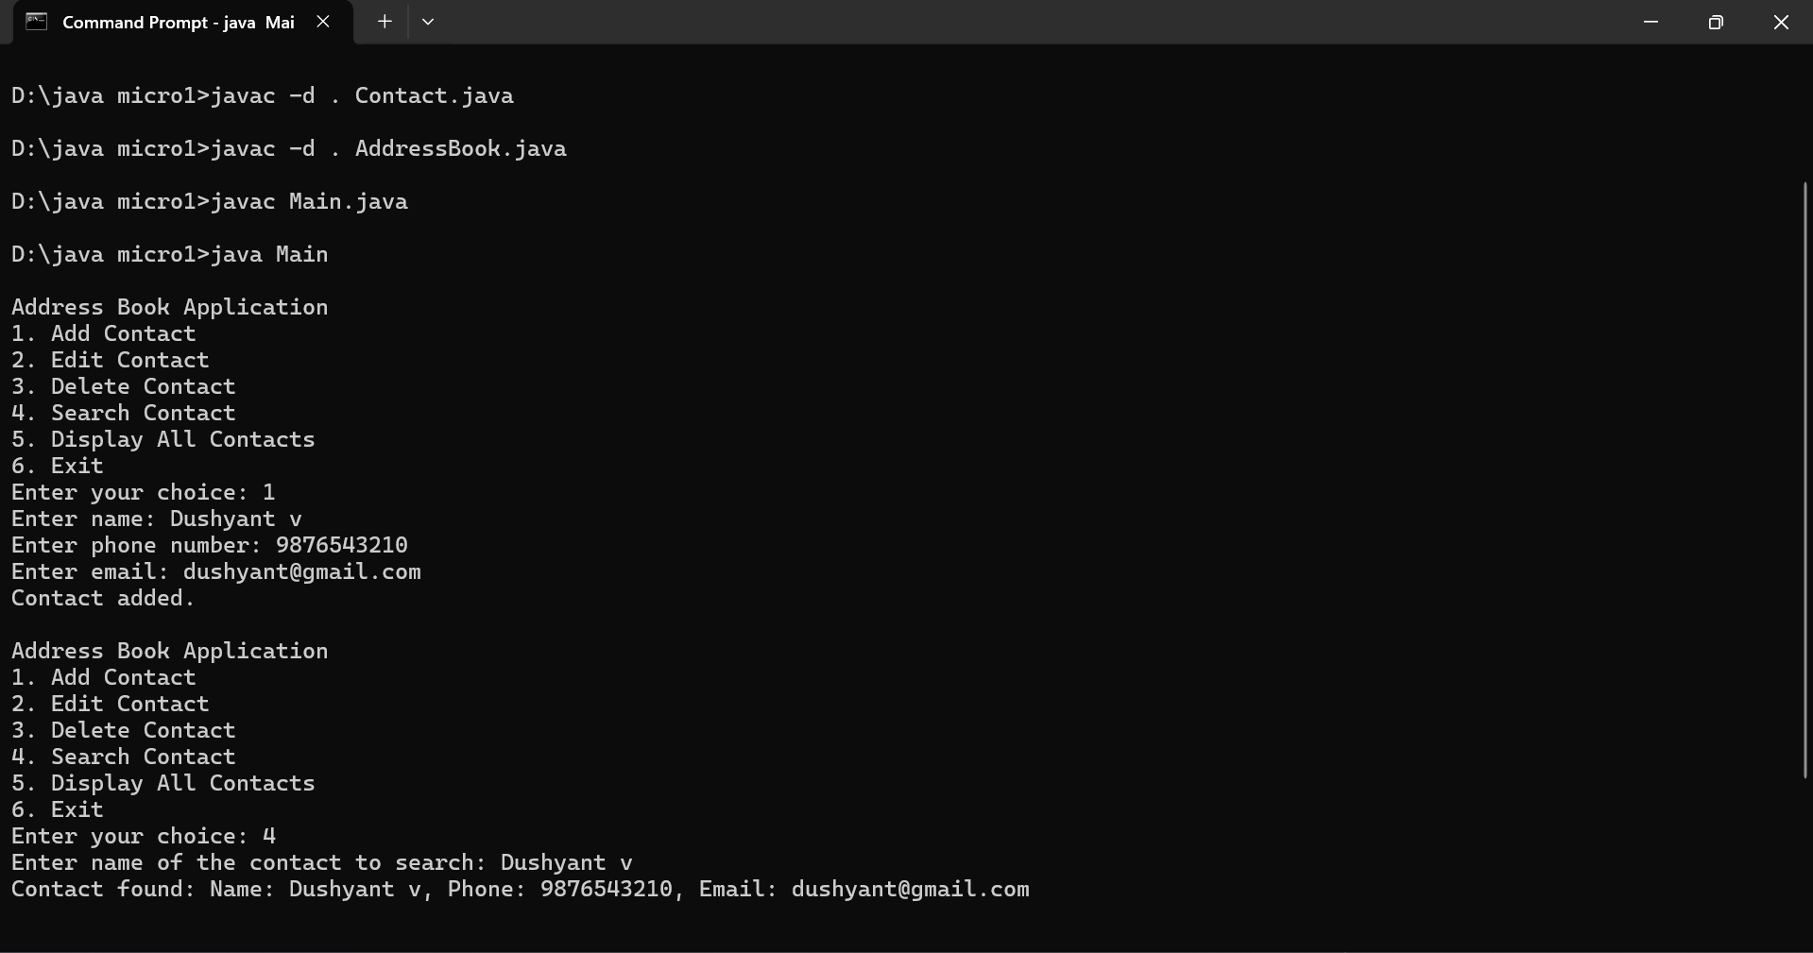

Slide 10
THANK YOU

